Slide 1
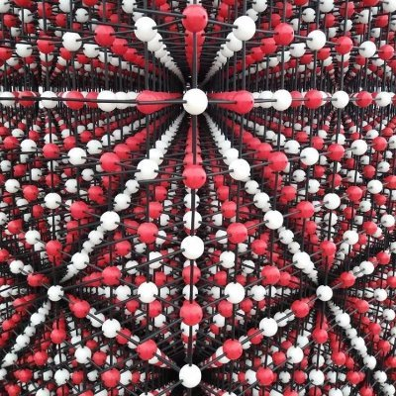
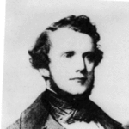
BPM: 2 Engineering Physics-II
UNIT –I: Crystal Structures and X-ray Diffraction
Lecture-5
By- Prof. B. K. Pandey, Dept. of Physics and Material Science
Auguste-Bravais

Slide 2
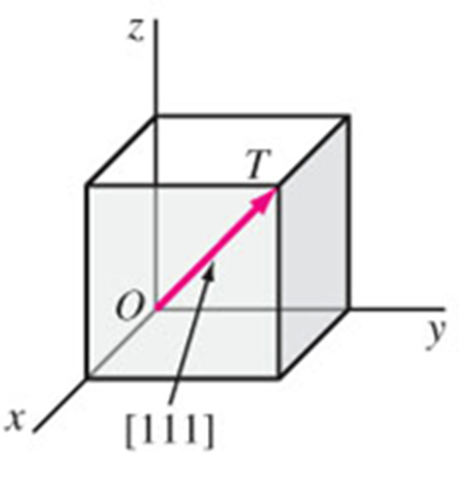
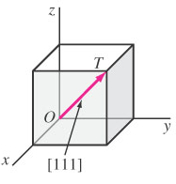
Crystal Directions
We choose one lattice point on the line as an origin, say the point O. Choice of origin is completely arbitrary, since every lattice point is identical.
Then we choose the lattice vector joining O to any point on the line, say point T. This vector can be written as;
R = n₁ a + n₂ b + n₃c
To distinguish a lattice direction from a lattice point, the triple is enclosed in square brackets [ ...] is used.[n₁n₂n₃]
[n₁n₂n₃] is the smallest integer of the same relative ratios.
Fig. Shows
[111] direction

Slide 3
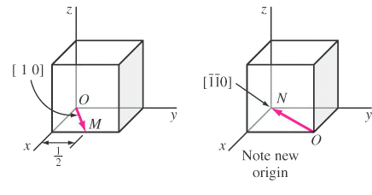
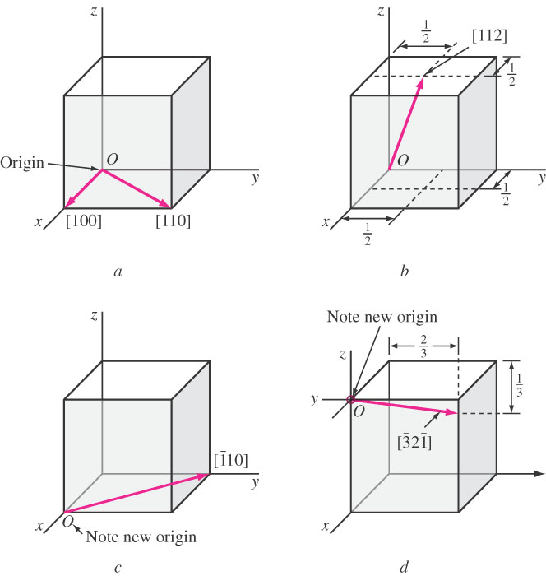
Examples
210
X = 1 , Y = ½ , Z = 0
[1 ½ 0] [2 1 0]
X = ½ , Y = ½ , Z = 1
[½ ½ 1] [1 1 2]

Slide 4
Negative directions
When we write the direction [n₁n₂n₃] depend on the origin, negative directions can be written as
R = n₁ a + n₂ b + n₃c
Direction must be
smallest integers.
Z direction
- X direction
(origin) O
- Y direction
Y direction
X direction
- Z direction

Slide 5
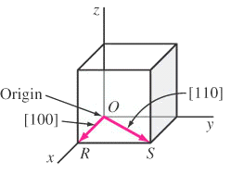
Examples of crystal directions
X = 1 , Y = 0 , Z = 0 [1 0 0]
X = -1 , Y = -1 , Z = 0 [110]

Slide 6
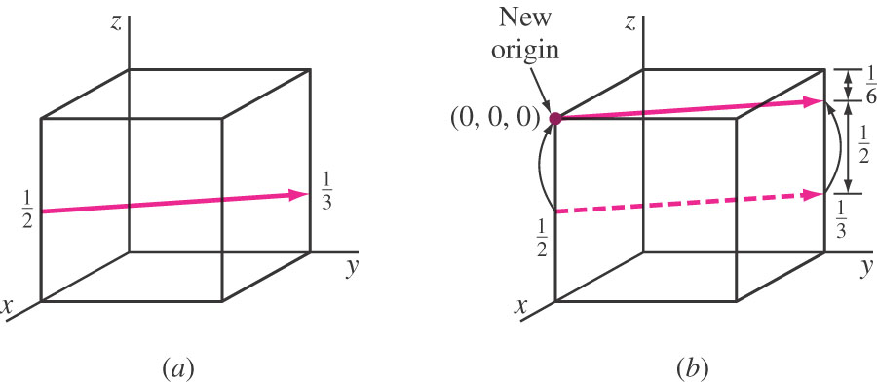
Examples
We can move vector to the origin.
X =-1 , Y = 1 , Z = -1/6
[-1 1 -1/6] [6 6 1]

Slide 7
Symmetry Element of a Crystalline Solids
Axis of symmetry
Plane of Symmetry
Centre of Symmetry

Slide 8
There are 13 axes of symmetry for a cube
Three axes have four fold symmetry know as tetrad. These axes pass through opposite face centres.
Four axes have three fold symmetry know as triad. These axes pass through diagonally opposite corners.
Six axes have two fold symmetry know as diad. These axes pass through the centers of opposite edges.

Slide 9
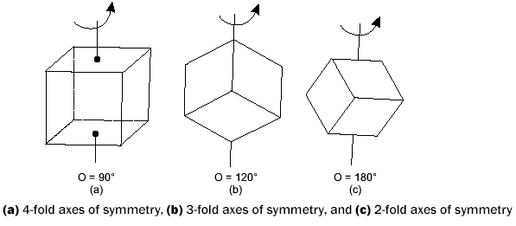
SYMMETRY ELEMENT OF A CRYSTALLINE SOLID
Axis of Symmetry
3 axes have four-fold symmetry known as tetrad. These axes pass through opposite face centres.
4 axes have three-fold symmetry known as triad. These axes pass through diagonally opposite corners.
6 axes have two-fold symmetry known as diad. These axes pass through the centres of opposite edges.

Slide 10
Planes of Symmetry
If a plane is able to cut a crystal into two halves in such a way that one half becomes the mirror image of the other half then the plane is known as plane of symmetry.
There are 9 such planes
3 are parallel to the faces of the cube.
6 are diagonal planes passing through diagonally opposite parallel edges.

Slide 11
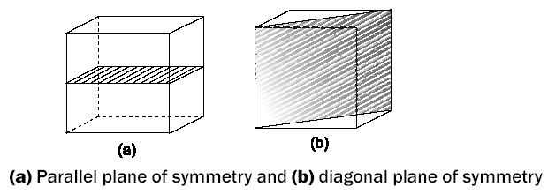
Planes of Symmetry
If a plane is able to cut a crystal into two halves in such a way that one half becomes the mirror image of the other half, then that plane is known as the plane of symmetry.
There are 9 planes—3 are parallel to the face of the cube and 6 are diagonal planes passing through diagonally opposite parallel edges.

Slide 12
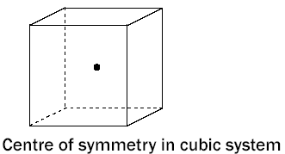
Centre of Symmetry
It is defined as a point in a crystal such that if a line is drawn from any point in the crystal through the point and an equal distance is produced on the other side of this central point, then it meets an identical point. There is only one centre of symmetry for cube system.

Slide 13
ELEMENTS OF SYMMETRY
Each of the unit cells of the 14 Bravais lattices has one or more types of symmetry properties, such as inversion, reflection or rotation,etc.
SYMMETRY
INVERSION
REFLECTION
ROTATION

Slide 14
Lattice goes into itself through
Symmetry without translation
Operation | Element
Inversion | Point
Reflection | Plane
Rotation | Axis
Rotoinversion | Axes

Slide 15
Crystal Planes
Within a crystal lattice it is possible to identify sets of equally spaced parallel planes. These are called lattice planes.
In the figure density of lattice points on each plane of a set is the same and all lattice points are contained on each set of planes.
The set of
planes in
2D lattice.
b
b
a
a

Slide 16

Coordination Number
Coordination Number (CN) : The Bravais lattice points closest to a given point are the nearest neighbours.
Because the Bravais lattice is periodic, all points have the same number of nearest neighbours or coordination number. It is a property of the lattice.
A simple cubic has coordination number 6;
A body-centered cubic lattice, 8;
A face-centered cubic lattice,12.

Slide 17
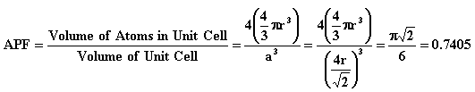
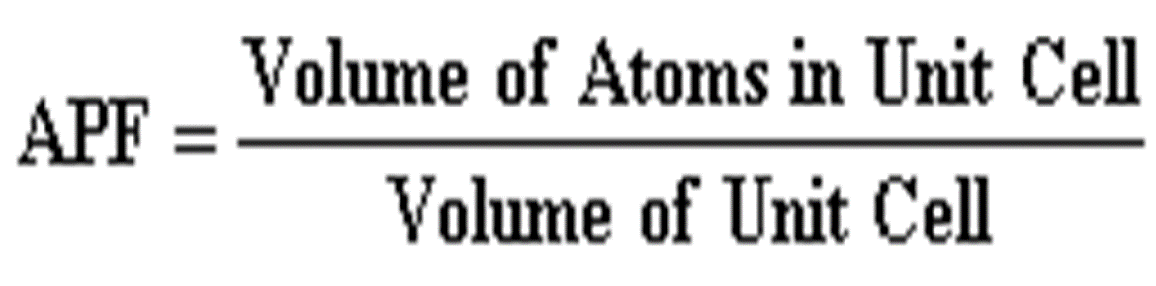
Atomic Packing Factor
Atomic Packing Factor (APF) is defined as the volume of atoms within the unit cell divided by the volume of the unit cell.

Slide 18
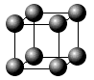
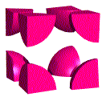
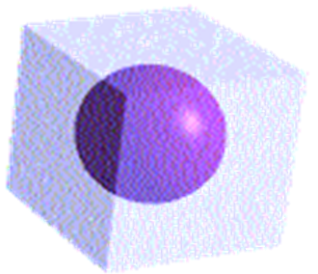
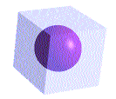
1-CUBIC CRYSTAL SYSTEM
a- Simple Cubic (SC)
Simple Cubic has one lattice point so its primitive cell.
In the unit cell on the left, the atoms at the corners are cut because only a portion (in this case 1/8) belongs to that cell. The rest of the atom belongs to neighboring cells.
Coordinatination number of simple cubic is 6.
b
c
a

Slide 19
Atomic Radius for SC
It is half the distance between any two nearest neighbors in the given crystal structure.
It is expressed in terms of cube edge a
a = 2r,
r = a/2
Atomic Radius, r = 0.5a
a

Slide 20
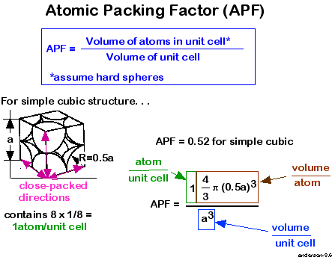
Atomic Packing Factor of SC

Slide 21
Discussions
APF = 0.52
That means that the percentage of packing is 52%
Thus, 52% of the volume of the simple cubic unit cell is occupied by atoms and the remaining 48% volume of unit cell is vacant or void space.

Slide 22
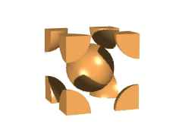
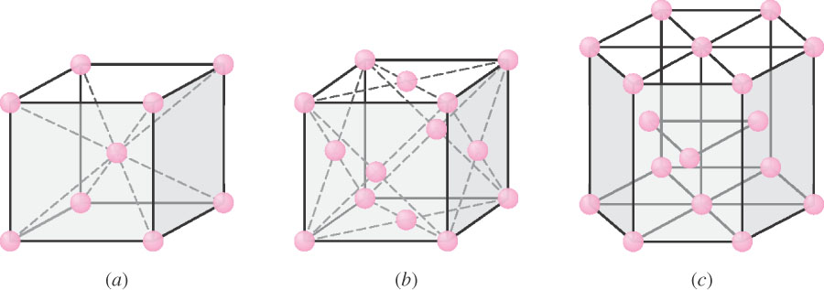
b-Body Centered Cubic (BCC)
BCC structure has 8 corner atoms and 1 body centre atom.
Each corner atom is shared by 8 unit cells.
The center atom is not shared by any of the unit cells.
So the
Number of atoms per unit cell
n = (1/8)x8 +1 = 2
b
c
a

Slide 23
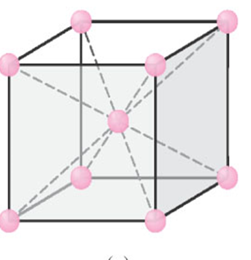
b-Body Centered Cubic (BCC)
BCC has two lattice points so BCC is a non-primitive cell.
BCC has eight nearest neighbors. Each atom is in contact with its neighbors only along the body-diagonal directions.
Hence, the coordination no. for BCC unit cell is 8
Many metals (Fe,Li,Na..etc), including the alkalis and several transition elements choose the BCC structure.
b
c
a

Slide 24
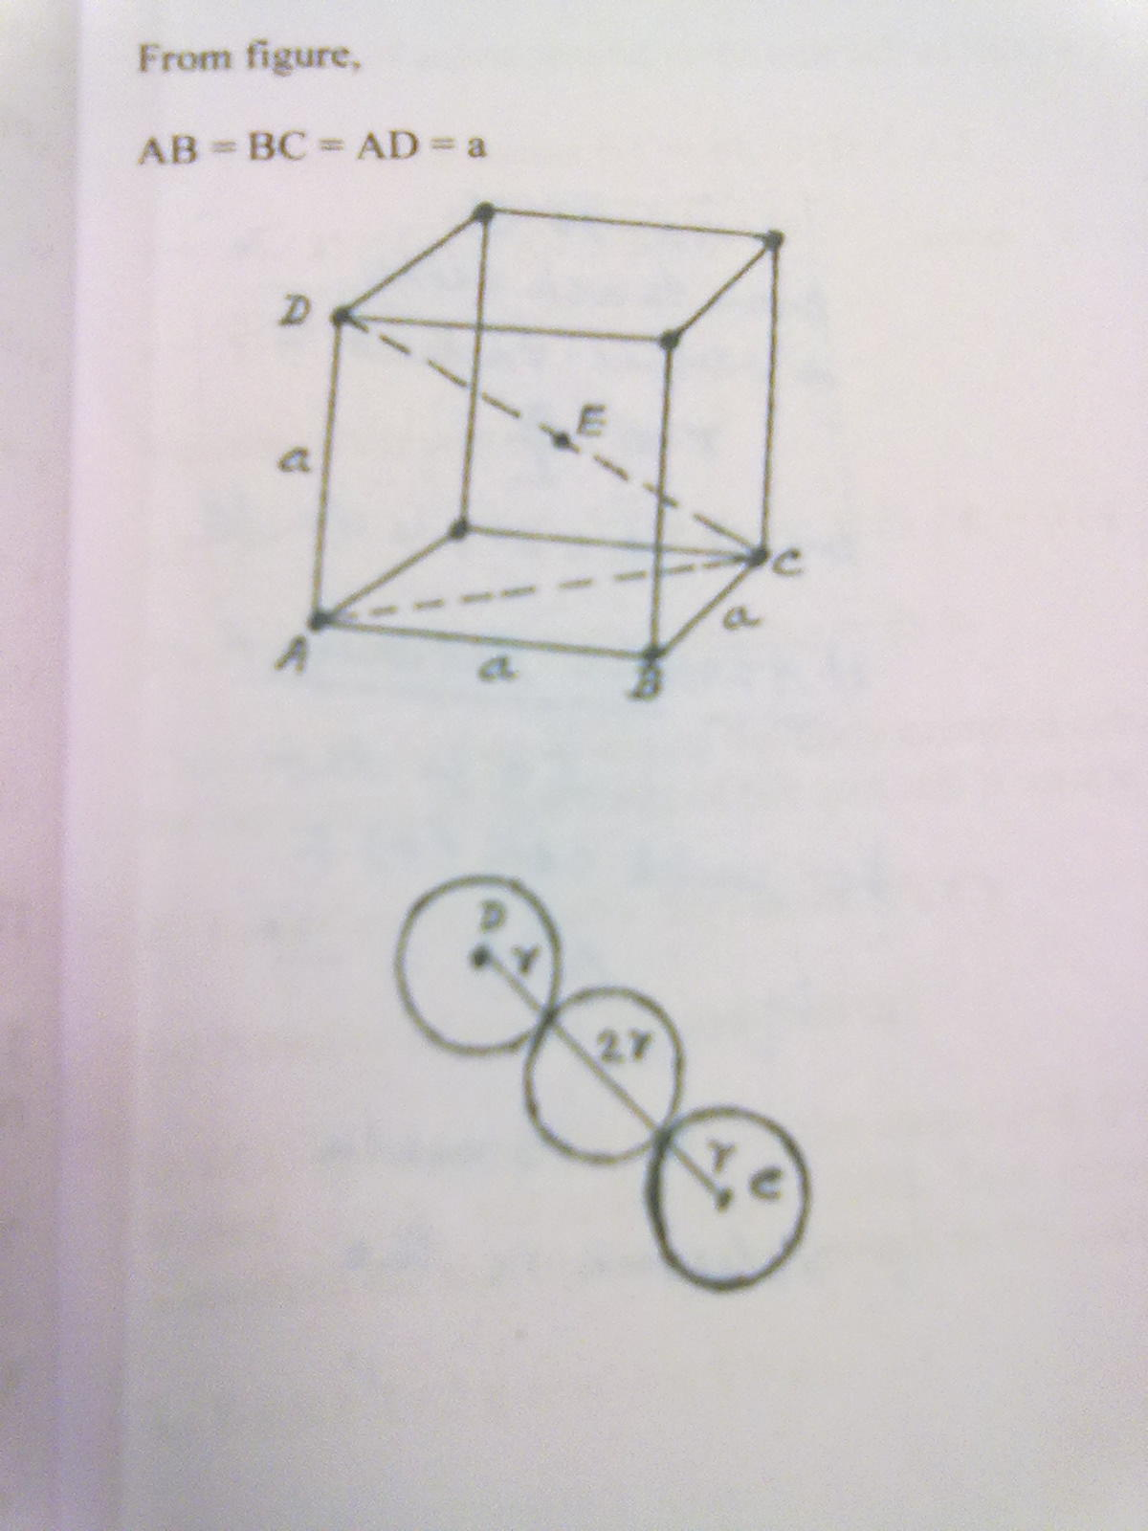
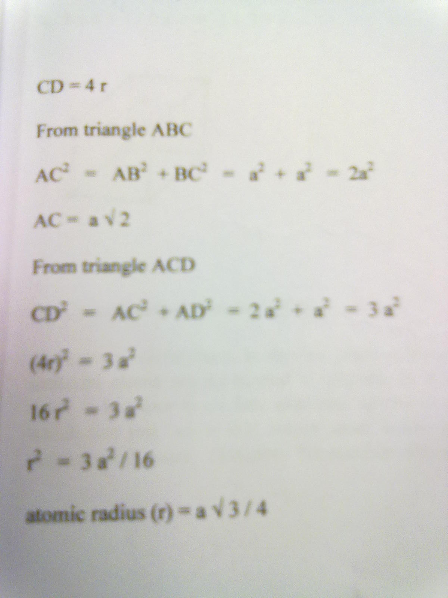
Atomic Radius for BCC unit cell
r =a x (3)^{1/2}/4

Slide 25
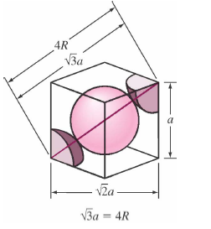
Atomic Packing Factor of BCC
2
(0,433a)

Slide 26
Atomic Packing Factor of BCC
The percentage of packing for BCC structure is 68%
Thus , 68% of the volume of body centered cubic cell is occupied by atoms and the remaining 32% of the volume is vacant or void space

Slide 27
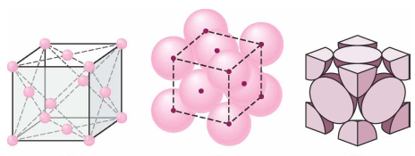
c- Face Centered Cubic (FCC)
FCC structure has 8 corner atoms and 6 face centre atoms.
Each corner atom is shared by 8 unit cells.
Each face centered atom is shared by 2 unit cells.
So the
Number of atoms present in unit cell is
n = (1/8 x8) + (1/2 x 6)
= 1 + 3
= 4

Slide 28
Co ordination Number
Face Centered Cubic (FCC)
The corner atom in its own plane touches 4 face centred atoms.
In the plane just above, the corner atom has another 4 face centered atoms as its nearest neighbours
Similarly, in the plane just below it has 4 more face centered atoms as its nearest neighbours
Therefore the no. of nearest neighbours are :
4 + 4 + 4 = 12

Slide 29
Many of common metals (Cu,Ni,Pb..etc) crystallize in FCC structure.

Slide 30
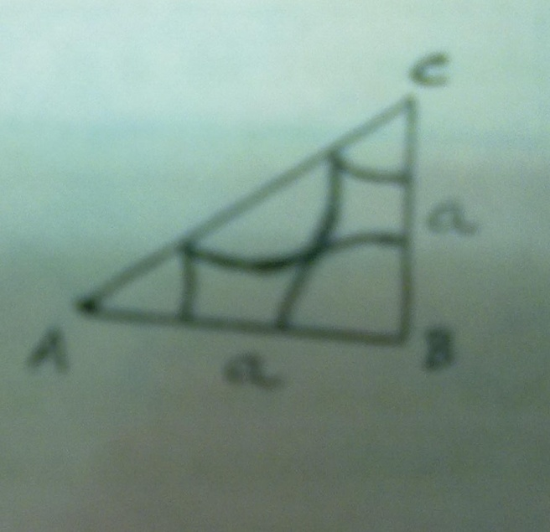
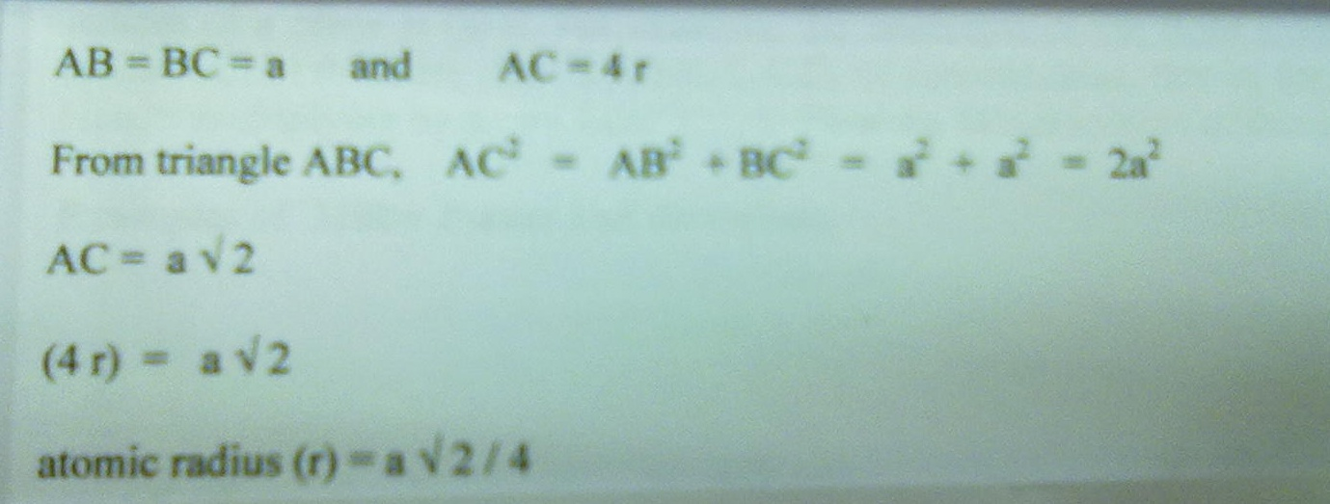
Atomic Radius for FCC
r = a x (2)^{1/2}/4

Slide 31
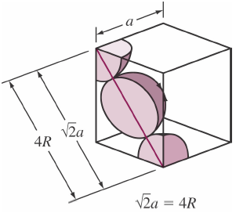
Atomic Packing Factor of FCC
0.74
FCC
4
(0.353a)

Slide 32
Unit cell contents
Counting the number of atoms within the unit cell
Atoms Shared Between: Each atom counts:
corner 8 cells 1/8
face centre 2 cells 1/2
body centre 1 cell 1
lattice type cell contents
P 1 [=8 x 1/8]
I 2 [=(8 x 1/8) + (1 x 1)]
F 4 [=(8 x 1/8) + (6 x 1/2)]

